Slide 1
XML for Android
Joesph Olliff

Slide 2
Topics
What is XML?
How XML works
The role that XML plays in Android Development
Tools you should be aware of.

Slide 3
What is XML?
eXtensible Markup Language
Similar to HTML in that it performs no logic
Used to store static resources in an organized manner that is independent of any application that may access the information

Slide 4
Advantages of XML
Platform Independent
Transports data and their relationships
Supports separation of concerns

Slide 5
Disadvantages of XML
No Universal Standard
Data integrity must be maintained by the applications that use the XML file
Requires separate parsing applications

Slide 6
How does XML work?
XML only has a handful of requirements to its layout. This is both a strength and a weakness
All XML files must begin with <?xml version=“1.0” encoding=“utf-8”?>
The XML document is a collection of Nodes that either contain further child nodes or some form of text
Remember the purpose of XML is store static resources in a well organized manner for other applications to use.

Slide 7
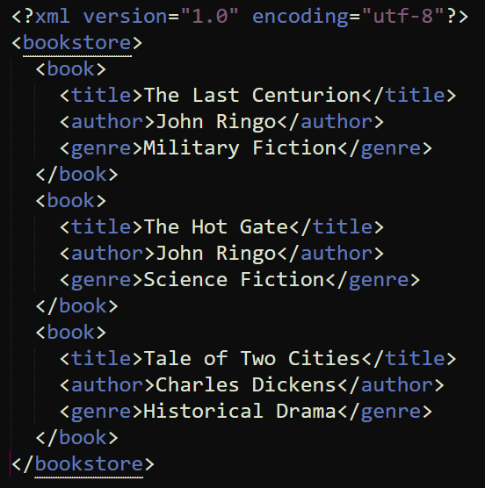
Example XML Document

Slide 8
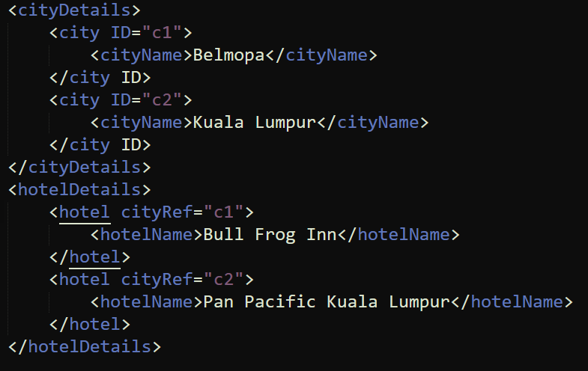
Example XML Document with Attributes

Slide 9
A Note About XML Schemas
XML Schemas (XSD) are a set of rules to describe the elements in an XML document
World Wide Web Consortium (W3C) provides some XSDs and links to include the Schema in your XML Document

Slide 10
How is XML used by Android
Describing Views!

Slide 11
How is XML used by Android
Store Application settings
AndroidManifest.xml contains your heading information that identifies your application and what libraries it needs to the Android OS.
To determine the layout and appearance of your User Interfaces (Activities)
Storage for any static resources, i.e. Help messages, notification text, etc..

Slide 12
Views
There are two kinds of views (what is actually displayed on the mobile device)
Linear Layout Views
Relative Layout Views

Slide 13
Linear Layout
Everything is positioned based off of the size of the screen or some other hard point
Used when the size of views within the layout will not change size or shape
Commonly used for loading screens and simple applications

Slide 14
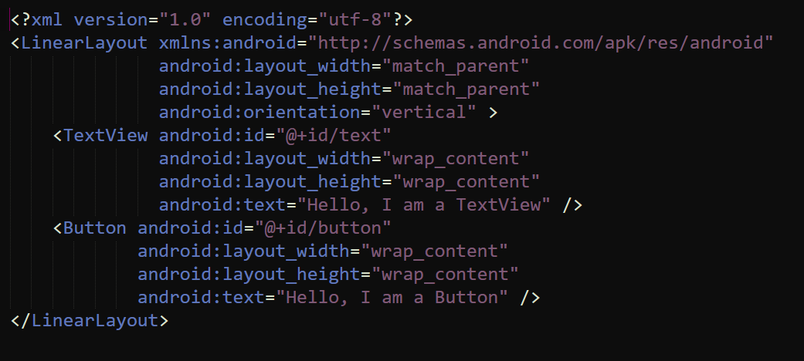
Linear Layout Example

Slide 15
Linear Layout Explained
‘@’ – This tells the XML parser that what is coming next is a directive
‘+’ – This tells the compiler that it is going to create a new resource
‘id’ – This tells the compiler that the resource it is going to make is an ID
‘/’ – Everything after this in the string is the ID you are giving this new resource
You can then refer to your new resource in the view like so:

Slide 16
Relative Layout
These look almost identical to a linear layout
However the positioning of resources are relative and subject to change
Used when the shape of views within the layout can change as the application runs

Slide 17
Tools for XML
There are several classes within the Xamarin library for working with XML files that store data.
One potential tool is the XmlDataDocument class in the System.Xml library
This loads the entire XML Document into a relational data structure
Every major language has its own libraries or tools for reading and editing XML documents.

Slide 18
Tools for XML
Views and layout are…
Automatically Loaded in C#!

Slide 19
Questions?

